Slide 1

Understand Conditional Access policies using Microsoft Endpoint Manager
Module 4

Slide 2

Learning objectives
In this module, you will:
Understand how to manage devices, apps, and policies based on groups.
Understand how trusted users can access organizational resources on trusted devices using trusted apps.
Learn about common ways to use Conditional Access.
Learn about configuring and managing device security.
Notes:
Microsoft Endpoint Manager uses groups to assign policies, such as Conditional Access policies and endpoint security policies. Conditional Access makes sure that only trusted users can access organizational resources on trusted devices using trusted apps.

Slide 3

Lesson 1: Conditional Access
What we will cover:
Understand how to manage devices, apps, and policies based on groups.
Understand how trusted users can access organizational resources on trusted devices using trusted apps.
Learn about common ways to use Conditional Access.
Learn about configuring and managing device security.
Notes:
Microsoft Endpoint Manager uses groups to assign policies, such as Conditional Access policies and endpoint security policies. These policies make up the rules that you and your organization use to ensure proper access and security. To control access to your organization's resources, such as email, files and data, you can use a Conditional Access policy. Conditional Access makes sure that only trusted users can access organizational resources on trusted devices using trusted apps. You can assign endpoint security policies to help provide security for your organization's devices and mitigate risk.
Intune uses Azure Active Directory (Azure AD) groups to manage devices and users. You can set up groups to suit your organizational needs. Create groups to organize users or devices by geographic location, department, or hardware characteristics. If your organization is large, you can use groups to manage tasks at scale. When you assign policies to users and devices, you use groups.
Suppose that you're the administrator of a company with several thousand employees. Your company must only allow employees with trusted credentials to access company information internally and externally. You must implement the rules that are enforced when employees attempt to access corporate data.
Here, you'll learn how you can use Microsoft Endpoint Manager and Conditional Access to protect your organization's data.

Slide 4
Policy management based on groups
You can add the following types of groups:
Assigned groups - Manually add users or devices into a static group.
Dynamic groups (Requires Azure AD Premium) - Automatically add users or devices to user groups or device groups based on an expression you create.
Notes:
You can manage assignments of devices, apps, and policies based on groups of users or devices.
You can add the following types of groups:
Assigned groups - Manually add users or devices into a static group.
Dynamic groups (Requires Azure AD Premium) - Automatically add users or devices to user groups or device groups based on an expression you create.

Slide 5
Managing Devices
You can create any device categories you want. For example:
Point-of-sale device
Demonstration device
Sales
Accounting
Manager
Notes:
o make managing devices easier, you can use Microsoft Intune device categories to automatically add devices to groups based on categories that you define.
Device categories use the following workflow:
Create categories that users can choose from when they enroll their device.
When users of iOS/iPadOS and Android devices enroll a device, they must choose a category from the list of categories you configured. To assign a category to a Windows device, users must use the Company Portal website.
You can then deploy policies and apps to these groups.
You can create any device categories you want. For example:
Point-of-sale device
Demonstration device
Sales
Accounting
Manager
After your device is enrolled, it becomes managed. Your organization can assign policies and apps to the device through a mobile device management (MDM) provider, such as Intune.

Slide 6

Managing Apps
Microsoft Intune can assign apps to:
Users and
Devices
In Intune can determine who has access to an app by:
Assigning groups of users to include and exclude.
Notes:
After you've added an app to Microsoft Intune, you can assign the app to users and devices. It is important to note that you can assign an app to a device whether or not the device is managed by Intune.
In Intune, you can determine who has access to an app by assigning groups of users to include and exclude. Before you assign groups to the app, you must set the assignment type for an app. The assignment type makes the app available, required, or uninstalls the app.
To set the availability of an app, you include and exclude app assignments to a group of users or devices by using a combination of include and exclude group assignments. This capability can be useful when you make the app available by including a large group, and then narrow the selected users by also excluding a smaller group. The smaller group might be a test group or an executive group.
As a best practice, create and assign apps specifically for your user groups, and separately for your device groups.
For example, when a user is added with the manager title, the user is automatically added to an All managers user group. Or, when a device has the iOS/iPadOS device OS type, the device is automatically added to an All iOS/iPadOS devices group.
After you assign an app to a group in Intune, you can assign policies for the app to users or devices.

Slide 7
Managing Apps Best Practice
Always create and assign apps specifically for
user groups, and
separately for your device groups.
For Example:
All Managers
All iOS/iPadOS Devices
Notes:
To set the availability of an app, you include and exclude app assignments to a group of users or devices by using a combination of include and exclude group assignments. This capability can be useful when you make the app available by including a large group, and then narrow the selected users by also excluding a smaller group. The smaller group might be a test group or an executive group.
As a best practice, create and assign apps specifically for your user groups, and separately for your device groups.
For example, when a user is added with the manager title, the user is automatically added to an All managers user group. Or, when a device has the iOS/iPadOS device OS type, the device is automatically added to an All iOS/iPadOS devices group.
After you assign an app to a group in Intune, you can assign policies for the app to users or devices.

Slide 8

Policy Assignments
Policies can be assigned to groups using Intune.
Assign policies to:
included and
excluded.
Notes:
Policies
Policies can be assigned to groups using Intune. When you assign policies, you can choose who will be included and who will be excluded.

Slide 9
Choosing the right group
User groups vs. Device groups
Device groups
Use to apply settings on single device,
regardless of who's signed in,
assign your profiles to a device group.
Note: Settings applied to device groups always go with the device, not the user.
Notes:
User groups vs. device groups
Many users ask when to use user groups and when to use device groups. The answer depends on your goal. Here's some guidance to get you started.
If you want to apply settings on a device, regardless of who's signed in, then assign your profiles to a device group. Settings applied to device groups always go with the device, not the user. Device groups are commonly used for shared and specialized devices.
For example:
Device groups are useful for managing devices that don't have a dedicated user. For example, you have devices that print tickets, scan inventory, are shared by shift workers, are assigned to a specific warehouse, and so on. Put these devices in a device group, and assign your profiles to this device group.
You create a Device Firmware Configuration Interface (DFCI) Intune profile that updates settings in the BIOS. For example, you configure this profile to disable the device camera, or lock down the boot options to prevent users from booting up another OS. This profile is a good scenario to assign to a device group.
On some specific Windows devices, you always want to control some Microsoft Edge settings, regardless of who's using the device. For example, you want to block all downloads, limit all cookies to the current browsing session, and delete the browsing history. For this scenario, put these specific Windows devices in a devices group. Then, create an Administrative Template in Intune, add these device settings, and then assign this profile to the device group.
To summarize, use device groups when you don't care who's signed in on the device, or if anyone is signed in. You want your settings to always be on the device.

Slide 10
Device Group
Scenarios 1:
Managing devices that don't have a dedicated user.
Print tickets,
scan inventory,
are shared by shift workers,
are assigned to a specific warehouse, and
so on.
Scenarios 2:
Device Firmware Configuration Interface (DFCI) Intune profile that updates settings in the BIOS.
Configure profile to disable the device camera,
Lockdown the boot options to prevent users from booting up another OS.
Notes:
Device groups
If you want to apply settings on a device, regardless of who's signed in, then assign your profiles to a device group. Settings applied to device groups always go with the device, not the user. Device groups are commonly used for shared and specialized devices.
For example:
Device groups are useful for managing devices that don't have a dedicated user. For example, you have devices that print tickets, scan inventory, are shared by shift workers, are assigned to a specific warehouse, and so on. Put these devices in a device group, and assign your profiles to this device group.
You create a Device Firmware Configuration Interface (DFCI) Intune profile that updates settings in the BIOS. For example, you configure this profile to disable the device camera, or lock down the boot options to prevent users from booting up another OS. This profile is a good scenario to assign to a device group.
On some specific Windows devices, you always want to control some Microsoft Edge settings, regardless of who's using the device. For example, you want to block all downloads, limit all cookies to the current browsing session, and delete the browsing history. For this scenario, put these specific Windows devices in a devices group. Then, create an Administrative Template in Intune, add these device settings, and then assign this profile to the device group.
To summarize, use device groups when you don't care who's signed in on the device, or if anyone is signed in. You want your settings to always be on the device.

Slide 11
User groups
Profile settings applied to user groups
Goes with the user when signed in to all their devices
Surface Pro for work,
a personal iOS/iPadOS device
Etc.
Notes:
always go with the user, and . It's normal for users to have many devices, such as a . And, it's normal for a person to access email and other organization resources from these devices. User groups are typically used for information works and knowledge workers.
For example:
You want to put a Help Desk icon for all users on all their devices. In this scenario, put these users in a user group, and assign your Help Desk icon profile to this user group.
A user receives a new organization-owned device. The user signs in to the device with their domain account. The device is automatically registered in Azure AD, and automatically managed by Intune. This profile is a good scenario to assign to a user group.
Whenever a user signs in to a device, you want to control features in apps, such as OneDrive or Office. In this scenario, assign your OneDrive or Office profile settings to a user group.
For example, you want to block untrusted ActiveX controls in your Office apps. You can create an Administrative Template in Intune, configure this setting, and then assign this profile to a user group.
To summarize, use user groups when you want your settings and rules to always go with the user, whatever device they use.

Slide 12
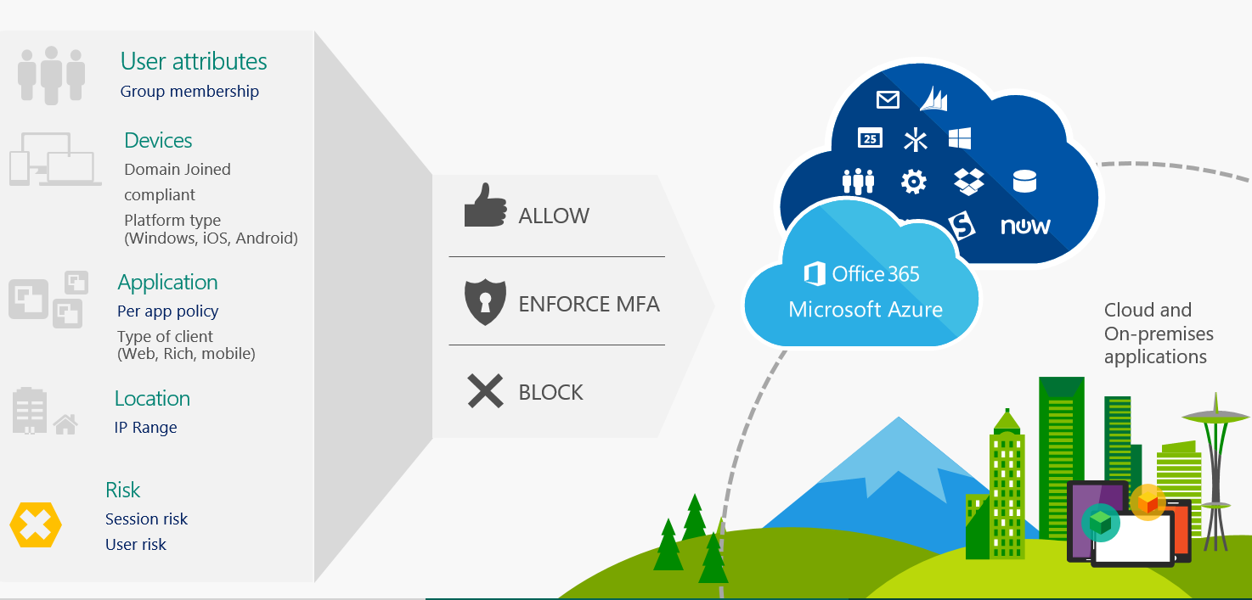
Applying Conditional Access
Notes:
As we mentioned, Conditional Access makes sure that only trusted users can access organizational resources on trusted devices using trusted apps. It's built from scratch in the cloud. Whether you're managing devices with Intune or extending your Configuration Manager deployment with co-management, it works the same way.
For example, Conditional Access allows you to control the devices and apps that can connect to your email. Conditional Access provides granular access control to keep your corporate data secure, while giving end users an experience that allows them to do their best work from any device. In fact, you can define conditions that gate access to your corporate data based on location, device, user state, and application sensitivity.
Conditional Access is an Azure Active Directory capability that is included with an Azure Active Directory Premium license. Intune enhances this capability by adding mobile device compliance and mobile app management to the solution.

Slide 13

Conditional Access with Intune
Intune provides the following types of Conditional Access:
Device-based Conditional Access
Conditional Access for Exchange on-premises
Conditional Access based on network access control
Conditional Access based on device risk
Conditional Access for Windows PCs
Corporate-owned
Bring your own device (BYOD)
App-based Conditional Access

Slide 14
Conditional Access using co-management
SCENARIO-1: Intune makes sure a device or app is managed and securely configured. This check depends on how you set your organization's compliance policies. For example, it makes sure all devices have encryption enabled and aren't jailbroken.
This evaluation is pre-security breach and configuration-based.
For co-managed devices, Configuration Manager also does configuration-based evaluation. For example, required updates or apps compliance. Intune combines this evaluation along with its own assessment.
SCENARIO-2: Intune detects active security incidents on a device. It uses the intelligent security of Microsoft Defender Advanced Threat Protection (formerly Windows Defender ATP) and other mobile threat defense providers. These partners run ongoing behavioral analysis on devices. This analysis detects active incidents, and then passes this information to Intune for real-time compliance evaluation.
This evaluation is post-security breach and incident-based.
Notes:
With co-management, Intune evaluates every device in your network to determine how trustworthy it is. It does this evaluation in the following two ways:
Intune makes sure a device or app is managed and securely configured. This check depends on how you set your organization's compliance policies. For example, make sure all devices have encryption enabled and aren't jailbroken.
This evaluation is pre-security breach and configuration-based.
For co-managed devices, Configuration Manager also does configuration-based evaluation. For example, required updates or apps compliance. Intune combines this evaluation along with its own assessment.
Intune detects active security incidents on a device. It uses the intelligent security of Microsoft Defender Advanced Threat Protection (formerly Windows Defender ATP) and other mobile threat defense providers. These partners run ongoing behavioral analysis on devices. This analysis detects active incidents, and then passes this information to Intune for real-time compliance evaluation.
This evaluation is post-security breach and incident-based.

Slide 15

Common ways to use Conditional Access
Need to configure the related compliance policies to
Used conditional access to enforce compliance in your organization.
Conditional Access is commonly to allow or block access to
Exchange,
Control access to the network, or
integrate with a Mobile Threat Defense solution.
Notes:
You need to configure the related compliance policies to drive Conditional Access compliance at your organization. Conditional Access is commonly used to do things like allow or block access to Exchange, control access to the network, or integrate with a Mobile Threat Defense solution.

Slide 16
Types of Conditional Access
Device-based Conditional Access
Conditional Access based on network access control
Conditional Access based on device risk
Notes:
Device-based Conditional Access
Intune and Azure Active Directory work together to make sure only managed and compliant devices can access email, Office 365 services, Software as a service (SaaS) apps, and on-premises apps. Additionally, you can set a policy in Azure Active Directory to only enable domain-joined computers or mobile devices that are enrolled in Intune to access Office 365 services.
Intune provides device compliance policy capabilities that evaluate the compliance status of the devices. The compliance status is reported to Azure Active Directory that uses it to enforce the Conditional Access policy created in Azure Active Directory when the user tries to access company resources.
Conditional Access based on network access control
Intune integrates with partners like Cisco ISE, Aruba Clear Pass, and Citrix NetScaler to provide access controls based on the Intune enrollment and the device compliance state.
Users can be allowed or denied access to corporate Wi-Fi or VPN resources based on whether the device they're using is managed and compliant with Intune device compliance policies.
Conditional Access based on device risk
Intune partners with Mobile Threat Defense vendors that provide a security solution to detect malware, Trojans, and other threats on mobile devices.

Slide 17
Intune and Mobile Threat Defense integration
Conditional Access for Windows PCs
Corporate-owned
Hybrid Azure AD joined
Azure AD domain joined and Intune management
Bring your own device (BYOD)
Workplace join and Intune management
App-based Conditional Access
Notes:
How the Intune and Mobile Threat Defense integration works
When mobile devices have the Mobile Threat Defense agent installed, the agent sends compliance state messages back to Intune reporting when a threat is found on the mobile device itself.
The Intune and mobile threat defense integration plays a factor in the Conditional Access decisions based on device risk.
Conditional Access for Windows PCs
Conditional Access for PCs provides capabilities similar to those available for mobile devices. Let's talk about the ways you can use Conditional Access when managing PCs with Intune.
Corporate-owned
Hybrid Azure AD joined: This option is commonly used by organizations that are reasonably comfortable with how they're already managing their PCs through AD group policies or Configuration Manager.
Azure AD domain joined and Intune management: This scenario is for organizations that want to be cloud-first (that is, primarily use cloud services, with a goal to reduce use of an on-premises infrastructure) or cloud-only (no on-premises infrastructure). Azure AD Join works well in a hybrid environment, enabling access to both cloud and on-premises apps and resources. The device joins to the Azure AD and gets enrolled to Intune, which can be used as a Conditional Access criteria when accessing corporate resources.
Bring your own device (BYOD)
Workplace join and Intune management: Here the user can join their personal devices to access corporate resources and services. You can use Workplace join and enroll devices into Intune MDM to receive device-level policies, which are another option to evaluate Conditional Access criteria.
App-based Conditional Access
Intune and Azure Active Directory work together to make sure only managed apps can access corporate e-mail or other Office 365 services.

Slide 18
Benefits of Conditional Access
IT team is obsessed with network security
Every organization has Mandatory IGA, PAM, IAM, PIM policies that must be enforced.
Conditional Access, you can determine the following factors:
If every device is encrypted
If malware is installed
If its settings are updated
If it's jailbroken or rooted
Notes:
Every IT team is obsessed with network security. It's mandatory to make sure that every device meets your security and business requirements before accessing your network. With Conditional Access, you can determine the following factors:
If every device is encrypted
If malware is installed
If its settings are updated
If it's jailbroken or rooted
Conditional Access combines granular control over organizational data with a user experience that maximizes worker productivity on any device from any location.
With co-management, Intune can incorporate Configuration Manager's responsibilities for assessing your security standards compliance of required updates or apps. This behavior is important for any IT organization that wants to continue using Configuration Manager for complex app and patch management.
Conditional Access is also a critical part of developing your Zero Trust Network architecture. With Conditional Access, compliant device access controls cover the foundational layers of Zero Trust Network. This functionality is a large part of how you secure your organization in the future.

Slide 19
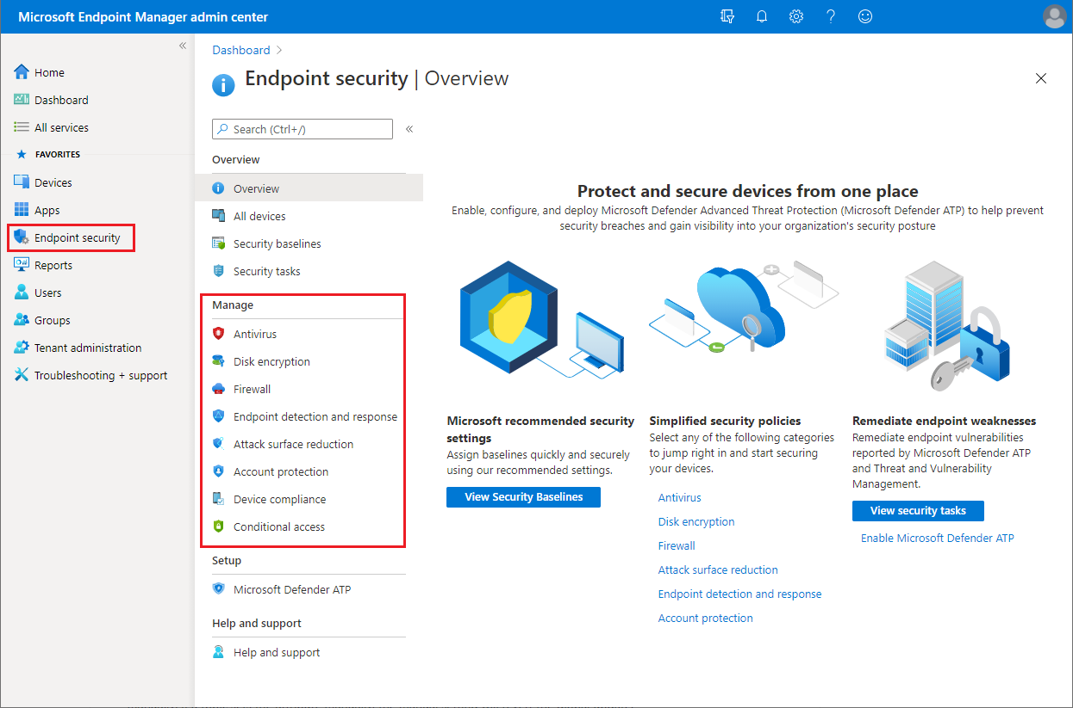
Implementing security rules
Notes:
You can use the Endpoint security node in Microsoft Endpoint Manager to configure device security and to manage security tasks for devices when those devices are at risk. The Endpoint security policies are designed to help you focus on the security of your devices and mitigate risk. The tasks that are available help you identify devices that are at risk, to remediate those devices, and restore them to a compliant or more secure state.

Slide 20
Endpoint security (Best Practice)
Keep
Keep devices secure
Review
Review the status of all your managed devices
Deploy
Deploy security baselines that establish best practice security configurations for devices
Manage
Manage security configurations on devices through tightly focused policies
Establish
Establish device and user requirements through compliance policy
Integrate
Integrate Intune with your Microsoft Defender ATP, and Integrate Configuration Manager with ATP.
Notes:
The Endpoint security node groups the tools that are available through Endpoint Manager that you use to keep devices secure:
Review the status of all your managed devices. You can view device compliance from a high level and then drill into specific devices to understand which compliance policies aren't met so you can resolve them.
Deploy security baselines that establish best practice security configurations for devices. Endpoint Manager includes security baselines for Windows devices and a growing list of applications, like Microsoft Defender Advanced Threat Protection (Microsoft Defender ATP) and Microsoft Edge. Security baselines are pre-configured groups of Windows settings that help you apply a known group of settings and default values that the relevant security teams recommend. You can use security baselines to rapidly deploy a best practice configuration of device and application settings to protect your users and devices. Security baselines are supported for devices that run Windows 10 version 1809 and later.
Manage security configurations on devices through tightly focused policies. Each endpoint security policy focuses on aspects of device security like antivirus, disk encryption, firewalls, and several areas made available through integration with Microsoft Defender ATP.
Establish device and user requirements through compliance policy. With compliance policies, you set the rules that devices and users must meet to be considered compliant. Rules can include OS versions, password requirements, device threat-levels, and more. When you integrate with Azure Active Directory (Azure AD) Conditional Access policies to enforce compliance policies, you can gate access to corporate resources for both managed devices, and devices that aren’t managed yet. Endpoint security policies are one of several methods in Endpoint Manager to configure settings on devices. When managing settings, it's important to understand what other methods are in use in your environment that can configure your devices, and avoid conflicts.
Integrate Intune with your Microsoft Defender ATP. By integrating with Microsoft Defender ATP you gain access to security tasks. Security tasks closely tie Microsoft Defender ATP and Intune together to help your security team identify devices that are at risk and hand-off detailed remediation steps to Intune admins who can then act.
Integrate Configuration Manager with ATP. Using tenant attach in a co-managed endpoint management scenario, you can integrate Configuration Manager with Microsoft Defender ATP to gain access to security tasks that help enterprises detect, investigate, and respond to advanced attacks on their networks.

Slide 21
Knowledge check
1. What is Conditional Access?
Conditional Access allows anonymous users to access organizational resources on trusted devices.
Conditional Access prevents trusted users from accessing trusted devices and trusted apps.
Conditional Access ensures that only trusted users can access organizational resources on trusted devices using trusted apps.
2. When you assign a policy, what is the difference between using an assigned group and using a dynamic group?
An assigned group is a group of users or devices that you manually add into a static group. A dynamic group is a group of users or devices that are automatically assigned based on an expression you create. In addition, dynamic groups requires Azure AD Premium.
An assigned group is a group of users or devices that automatically set. A dynamic group is a group of users that you manually set.
For policies, there are no differences when assigning based on assigned group or dynamic group.
3. When would you assign a policy to a device group?
Assign a policy to a device group when you want to have different policy settings for each user.
If you want to apply policy settings on a device, regardless of who's signed in, then assign your policies to a device group.
If you don't want to have any policy settings for the device, use a device group.
4. It is possible to integrate Microsoft Defender ATP with Intune, but is it possible to integrate Microsoft Defender ATP with Configuration Manager?
True. Using tenant attach in a co-managed endpoint management scenario, you can integrate Configuration Manager with Microsoft Defender ATP to gain access to security tasks that help enterprises detect, investigate, and respond to advanced attacks on their networks.
False. You can only integrate Microsoft Defender ATP with Intune.
Notes:
C
A
B
True

Slide 22
Knowledge check
1. What is Conditional Access?
Conditional Access allows anonymous users to access organizational resources on trusted devices.
Conditional Access prevents trusted users from accessing trusted devices and trusted apps.
Conditional Access ensures that only trusted users can access organizational resources on trusted devices using trusted apps.
2. When you assign a policy, what is the difference between using an assigned group and using a dynamic group?
An assigned group is a group of users or devices that you manually add into a static group. A dynamic group is a group of users or devices that are automatically assigned based on an expression you create. In addition, dynamic groups requires Azure AD Premium.
An assigned group is a group of users or devices that automatically set. A dynamic group is a group of users that you manually set.
For policies, there are no differences when assigning based on assigned group or dynamic group.
3. When would you assign a policy to a device group?
Assign a policy to a device group when you want to have different policy settings for each user.
If you want to apply policy settings on a device, regardless of who's signed in, then assign your policies to a device group.
If you don't want to have any policy settings for the device, use a device group.
4. It is possible to integrate Microsoft Defender ATP with Intune, but is it possible to integrate Microsoft Defender ATP with Configuration Manager?
True. Using tenant attach in a co-managed endpoint management scenario, you can integrate Configuration Manager with Microsoft Defender ATP to gain access to security tasks that help enterprises detect, investigate, and respond to advanced attacks on their networks.
False. You can only integrate Microsoft Defender ATP with Intune.

Slide 23
Summary
Here are some of the things we covered:
Adding assigned groups and dynamic groups to manually or automatically assign groups in Microsoft Endpoint Manager.
The difference between user groups and device groups.
How trusted users can access organizational resources on trusted devices using trusted apps.
The common ways to use Conditional Access.
Configuring device security and managing security tasks for devices.

